Slide 1
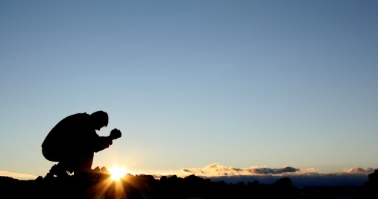
CHANGE AGENTS
PRAYER
Ephesians 3: 14 - 21

Slide 2
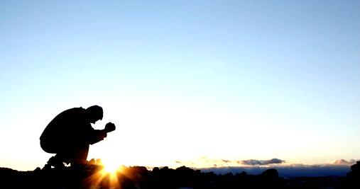
Eph 3:14-21
For this reason I kneel before the Father, from whom his whole family in heaven and on earth derives its name. I pray that out of his glorious riches he may strengthen you with power through his Spirit in your inner being, so that Christ may dwell in your hearts through faith.

Slide 3
And I pray that you, being rooted and established in love, may have power, together with all the saints, to grasp how wide and long and high and deep is the love of Christ, and to know this love that surpasses knowledge

Slide 4
— that you may be filled to the measure of all the fullness of God.
Now to him who is able to do immeasurably more than all we ask or imagine, according to his power that is at work within us, to him be glory in the church and in Christ Jesus throughout all generations, for ever and ever! Amen.
NIV

Slide 5
CHANGE AGENTS
PRAYER
Ephesians 3: 14 - 21

Slide 6
PRAYER is a Change Agent!
THE POSTURE FOR PRAYER: Verse 14
Eph 3:14
For this reason I KNEEL before the Father, NIV

Slide 7
1 Kings 8:22
…….. STOOD before the altar of the Lord in front of the whole assembly of Israel, spread out his hands toward heaven NIV
1 Chron 17:16
Then King David went in and SAT before the Lord NIV
Matt 26:39
Going a little farther, he FELL with his Face to the Ground and prayed, NIV

Slide 8
THE PETITION: Verses 16 – 19
HE ASKS FOR 4 THINGS:
STRENGTH V. 16
DEPTH V. 17
GRASP V. 18 – 19a
FULLNESS V. 19B

Slide 9
STRENGTH – Verse 16
DEPTH – Verse 17
DWELL
ROOTED
GROUNDED

Slide 10
GRASP – Verses 18 – 19a
"I can do all things through Christ which strengtheneth me" writes Paul in Phil 4:13.

Slide 11
FULLNESS – Verse 19b
John Owen….
“We are never nearer Christ than when we find ourselves lost in a holy amazement at his unspeakable love.”

